Slide 1
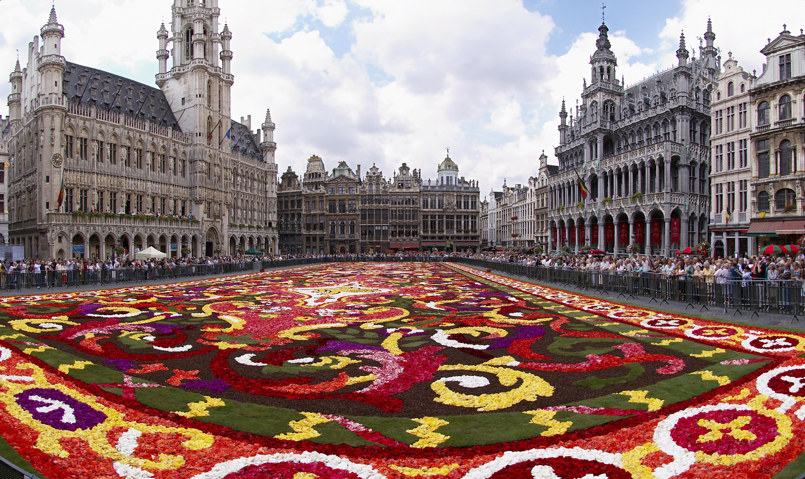
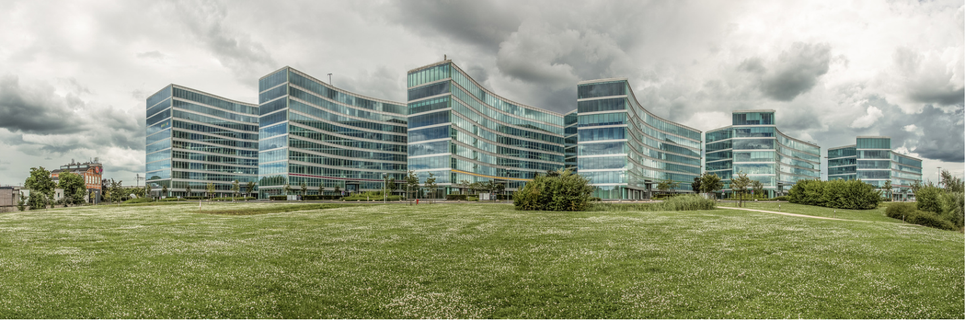



5 Décembre 2016
Journée aOS Bruxelles
aOS

Slide 2
December 5th, 2016
aOS Day Brussels
aOS

Slide 3
Start with Windows Containers
Florent Appointaire
@florent_app

Slide 4

Speaker presentation
MVP Cloud and Datacenter Management
Senior Consultant @ DevoTeam
Member of the SCUG BE and CMD communities
Twitter: @florent_app
Github: https://github.com/Flodu31
Blog FR: http://microsofttouch.fr/default/b/florent/
Blog EN: http://scug.be/florent

Slide 5
Agenda
Windows Containers
What’s it?
Hyper-V Containers
Windows Server Containers
How to use it?
Demonstration
Questions/Answers

Slide 6
Windows Containers
Florent Appointaire
@florent_app

Slide 7
What’s it?
Like Linux Containers but for Windows
Only Windows Containers are running on a Windows Computer and vice-versa
Windows Server Containers / Hyper-V Containers
Difference is isolation level

Slide 8
Windows Server Containers
Windows Server containers – multiple container instances can run concurrently on a host, with isolation provided through namespace, resource control, and process isolation technologies. Windows Server containers share the same kernel with the host, as well as each other.
Source: https://msdn.microsoft.com/en-us/virtualization/windowscontainers/management/hyperv_container?f=255&MSPPError=-2147217396

Slide 9
Windows Server Containers
Host User Mode
System Processes
Session Manager
Container Management
Windows Server Container
Windows Server Container
Local Security Authority
Docker Engine
Event Manager…
System Processes
Application Processes
System Processes
Application Processes
Compute Services
Etc…
Job Object
Net Interface
Storage
Registry
Job Object
Net Interface
Storage
Registry
Windows Kernel

Slide 10
Hyper-V Containers
Hyper-V containers – multiple container instances can run concurrently on a host; however, each container runs inside of a special virtual machine. This provides kernel level isolation between each Hyper-V container and the container host.
Source: https://msdn.microsoft.com/en-us/virtualization/windowscontainers/management/hyperv_container?f=255&MSPPError=-2147217396

Slide 11
Hyper-V Containers
Host User Mode
Virtual Machine Specifically Optimized To Run a Container
System Processes
Hyper-V Container
Session Manager
Container Management
Windows Server Container
Guest Compute Service
Local Security Authority
Docker Engine
System Processes
Application Processes
Event Manager…
Compute Services
Basic System Processes
Etc…
Job Object
Net Interface
Storage
Registry
Windows Kernel
Windows Kernel
Hyper-V Hypervisor

Slide 12
How to use it?
Florent Appointaire
@florent_app

Slide 13
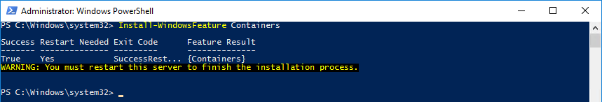
Installation on Windows Server 2016
PowerShell:
Install-WindowsFeature Containers
Restart-Computer
Installation possible with the Server Manager

Slide 14
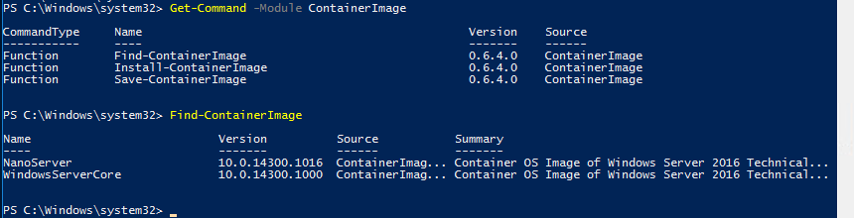
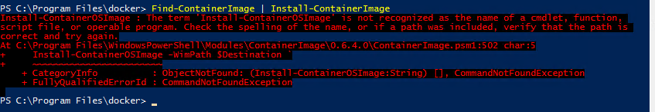
Installation sur Windows Server 2016
Install-PackageProvider ContainerImage
Get-Command -Module ContainerImage
Find-ContainerImage | Install-ContainerImage

Slide 15
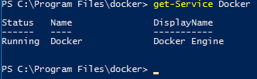
Installation of Docker on Windows Server 2016
Invoke-WebRequest " https://master.dockerproject.org/windows/amd64/docker-1.14.0-dev.zip" -OutFile "$env:TEMP\docker.zip" –UseBasicParsing
Expand-Archive -Path "$env:TEMP\docker.zip" -DestinationPath $env:ProgramFiles
[Environment]::SetEnvironmentVariable("Path", $env:Path + ";C:\Program Files\Docker", [EnvironmentVariableTarget]::Machine)
C:\ProgramFiles\docker\dockerd.exe --register-service
Start-Service Docker
Source: https://msdn.microsoft.com/en-us/virtualization/windowscontainers/docker/configure_docker_daemon?f=255&MSPPError=-2147217396

Slide 16
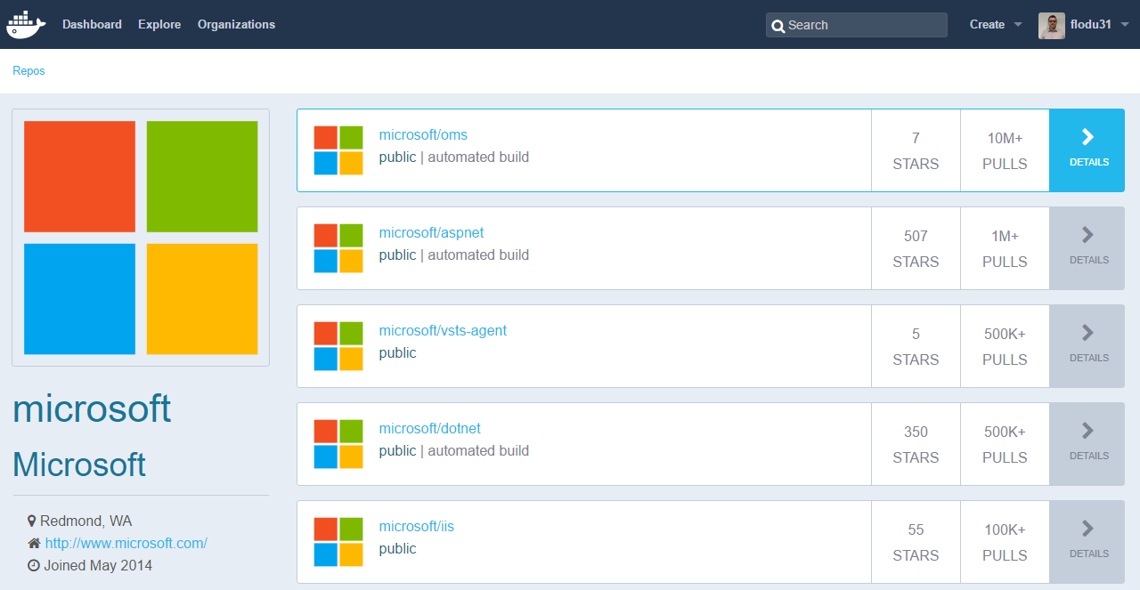
Docker Images
One link: https://hub.docker.com/
Microsoft Docker Images: https://hub.docker.com/u/microsoft/

Slide 17
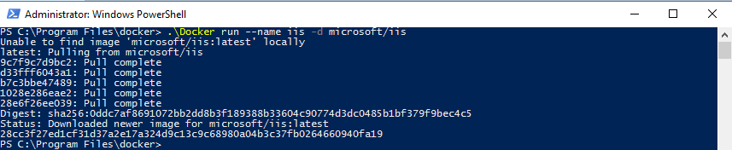
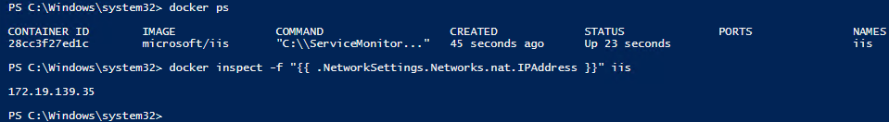
First container
Docker run --name iis -d microsoft/iis –p 8080:80

Slide 18
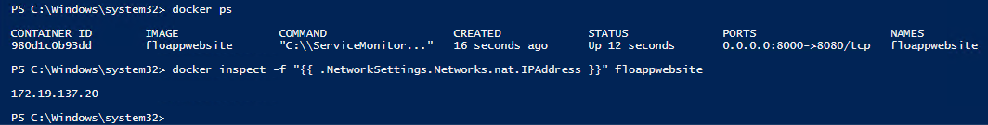
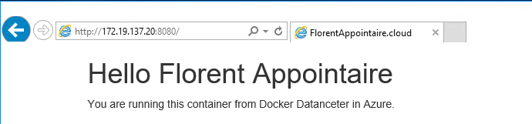
Create a container based on your personal website
Docker build -t floappwebsite .
Docker run --name floappwebsite -d floappwebsite –p 8000:8080
Docker inspect -f "{{ .NetworkSettings.Networks.nat.IPAddress }}" floappwebsite

Slide 19
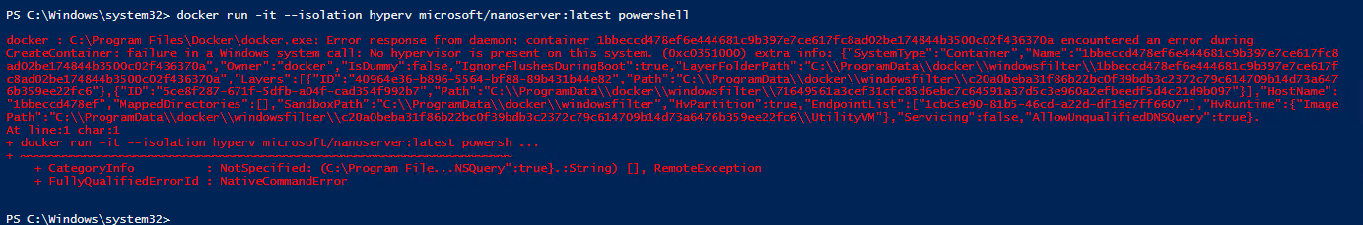
Hyper-V Container
Docker run -it --isolation hyperv microsoft/nanoserver:latest powershell

Slide 20
Demonstration
Florent Appointaire
@florent_app

Slide 21
Questions/Answers
Florent Appointaire
@florent_app

Slide 22




Gold

Slide 23
5 Décembre 2016
Journée aOS Bruxelles
aOS

Slide 24
December 5th, 2016
aOS Day Brussels
aOS

